Slide 1

Image Composite Editor
David Ishak Kosasih – 20195033 | Dongseo University

Slide 2
Introduction
Name : David Ishak Kosasih
Nationality : Indonesia
Date of birth : 14 January 1994
Education :
2013-2017
BEng Electrical engineering, Petra Christian University
Thesis : Making Mobile Application For Parking Systems Based on
Internet of Things (IoT)
Research Experience :
2018-2019
Incubator Tenants, Innovation & Entrepreneurship Centre
Current research topic
Wearable sensor and cloud computing
Title : Wearable sensor for elderly healthcare monitoring system

Slide 3
Image Composite Editor
What is Image Composite Editor (ICE)?
Image Composite Editor (ICE) is an advanced panoramic image stitcher created by the Microsoft Research Computational Photography Group.
What is image stitching?
The idea behind Image Stitching is to construct seamless high definition panoramic view using different viewpoints with multiple smaller overlapping images. (O. S. Vaidya and S. T. Gandhe, "The Study of Preprocessing and Postprocessing Techniques of Image Stitching," 2018 International Conference On Advances in Communication and Computing Technology (ICACCT), Sangamner, 2018, pp. 431-435)
Most approaches to image stitching require nearly exact overlaps between images and identical exposures to produce seamless results. (Wikipedia - Image stitching)

Slide 4
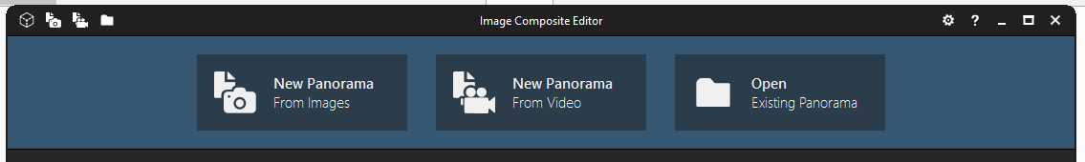
Image Composite Editor
Panorama From Image
Panorama From Video

Slide 5
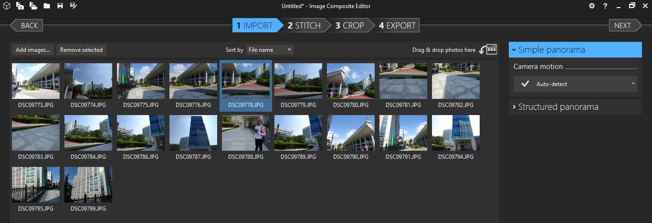
Panorama From Image
Import

Slide 6
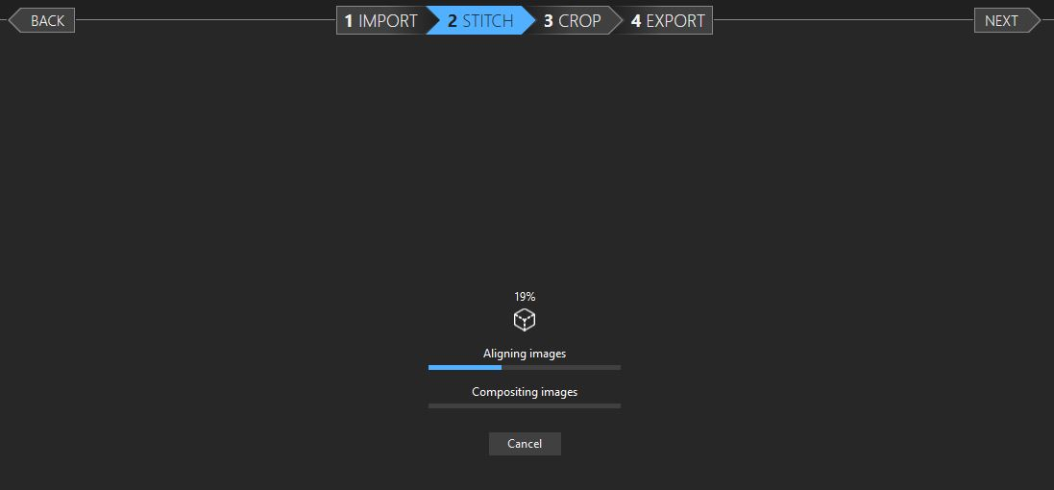
Panorama From Image
Stitching Process :

Slide 7
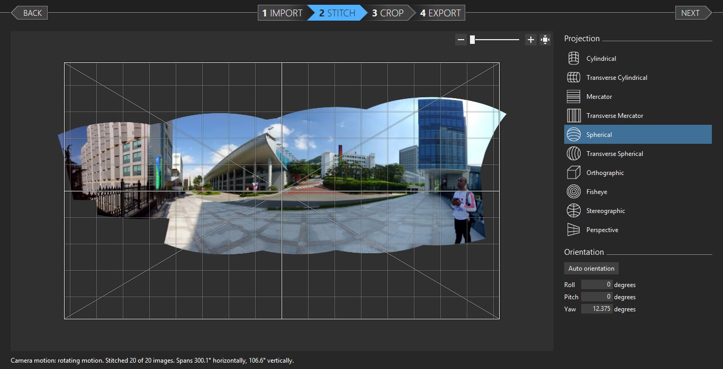
Panorama From Image
Stitching Result :

Slide 8
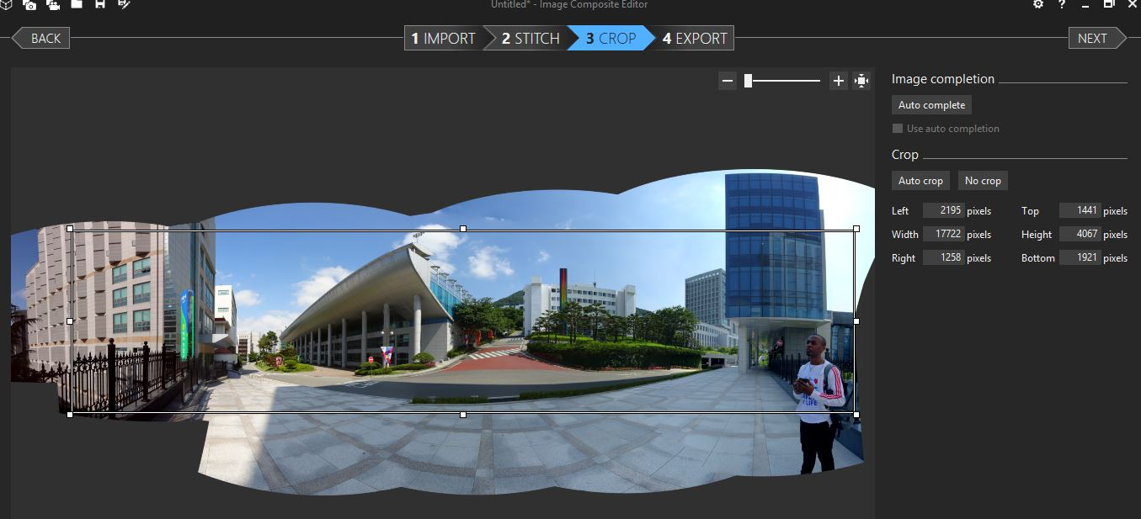
Panorama From Image
Crop :

Slide 9
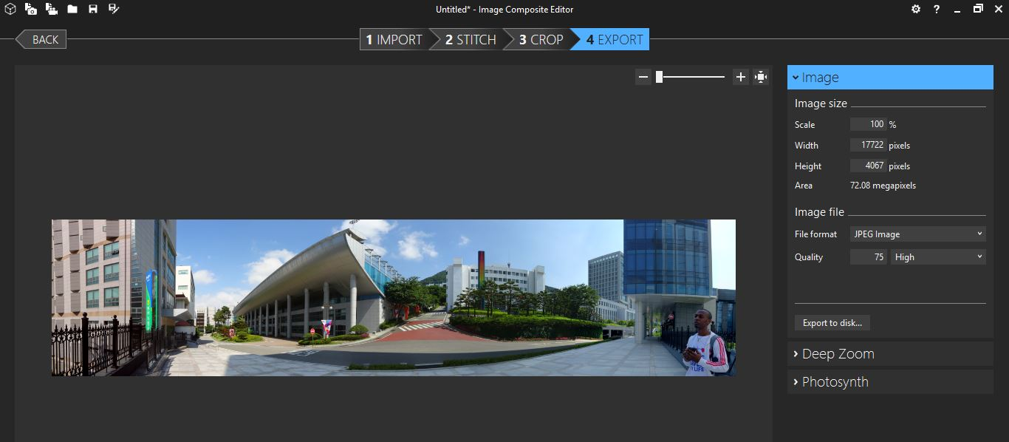
Panorama From Image
Export :

Slide 10
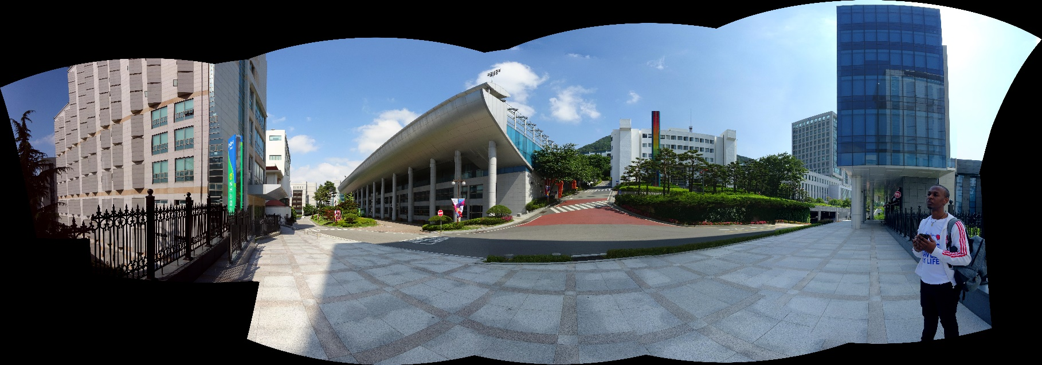
Panorama From Image
Original Result :

Slide 11
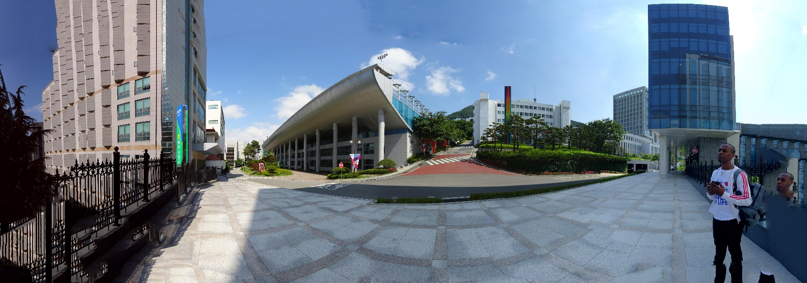
Panorama From Image
Auto Complete Result :

Slide 12
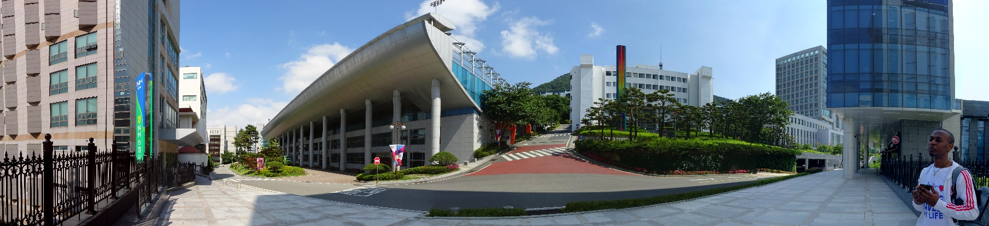
Panorama From Image
Self-Cropping Result :

Slide 13
Panorama From Video
Creating 360 image panorama
Creating panorama that include moving object

Slide 14
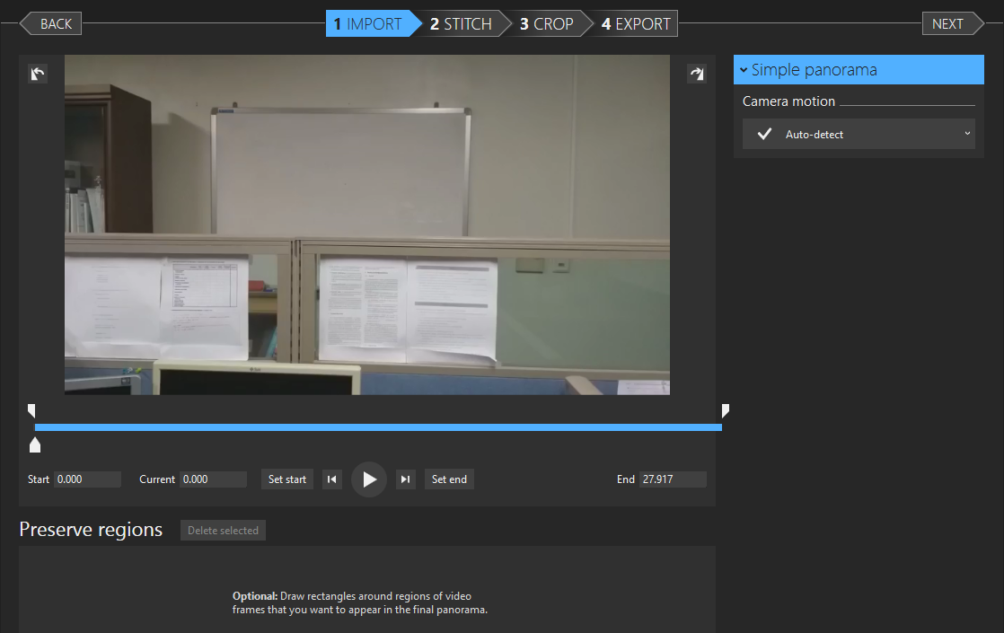
Creating 360 image
Import :

Slide 15
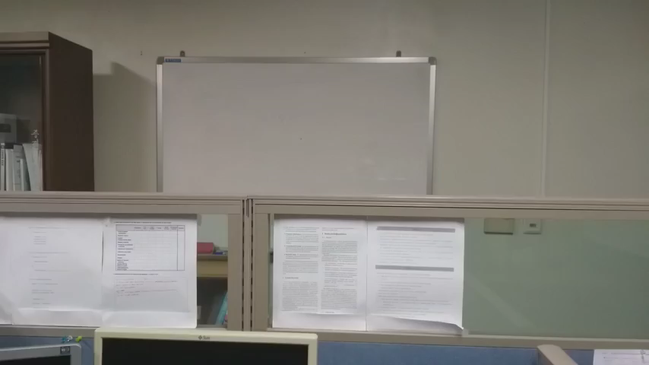
Creating 360 image
Video :

Slide 16
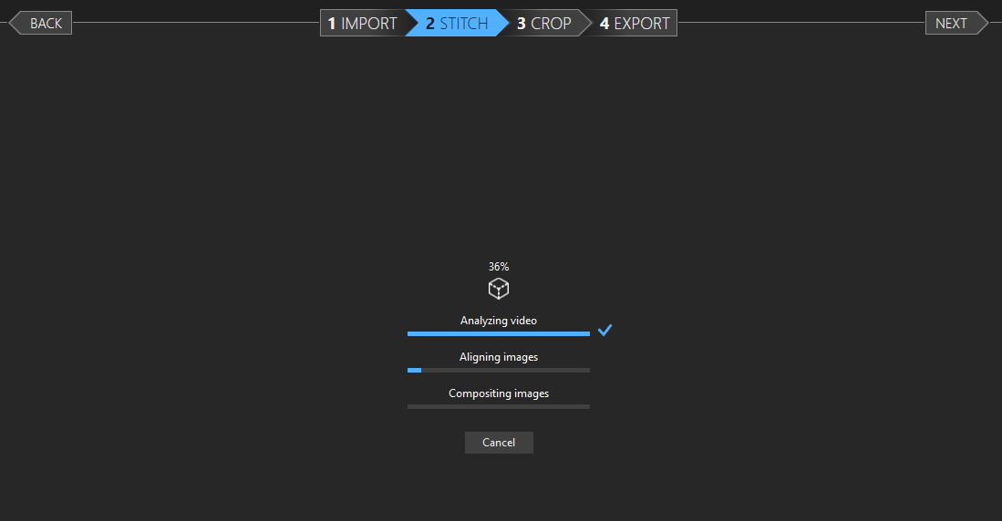
Creating 360 image
Stitching Process :

Slide 17
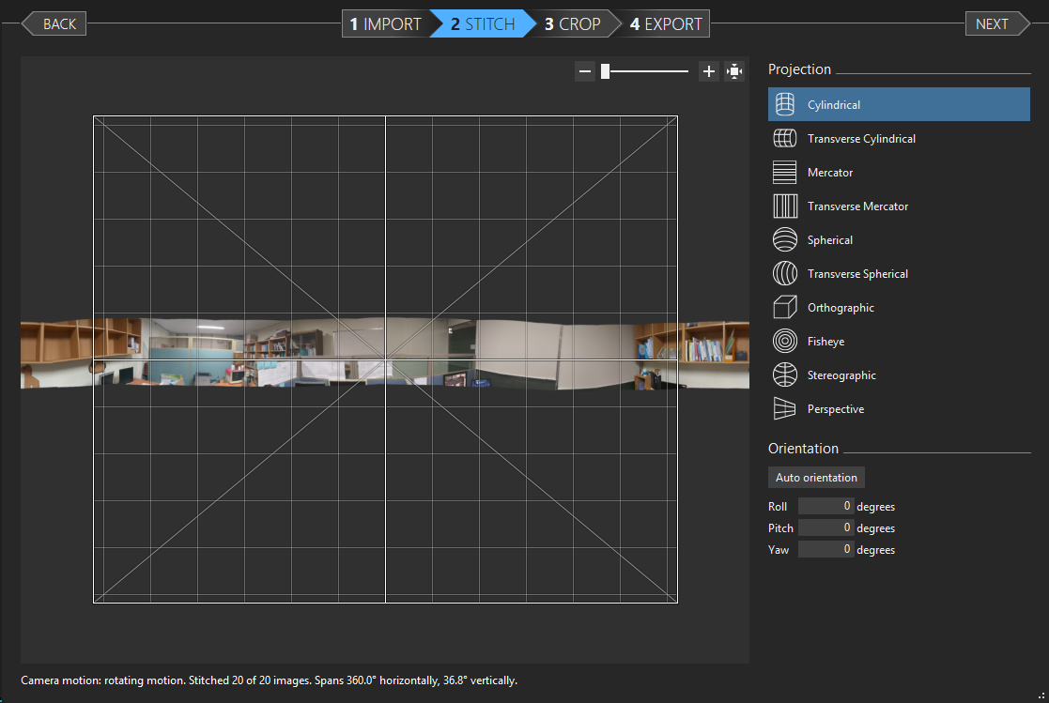
Creating 360 image
Stitching Result :

Slide 18
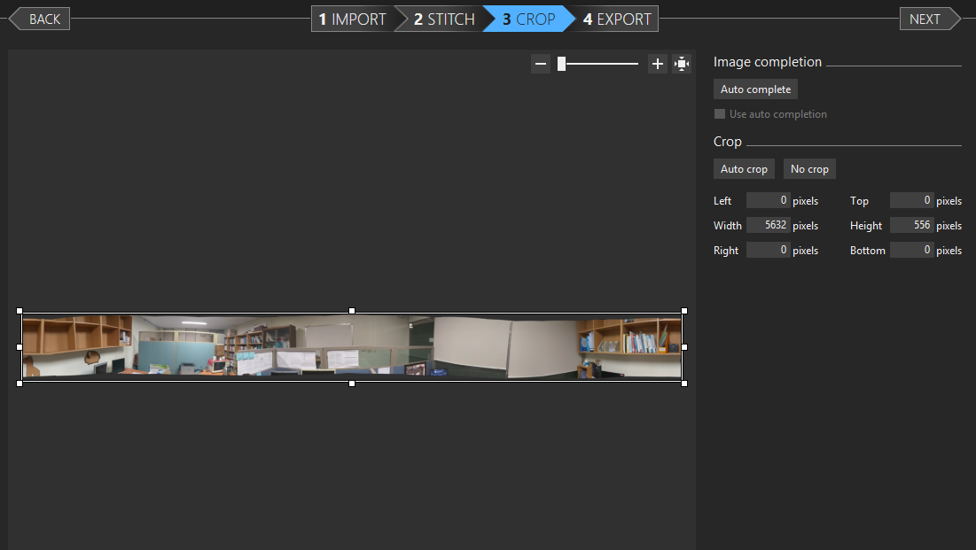
Creating 360 image
Crop :

Slide 19
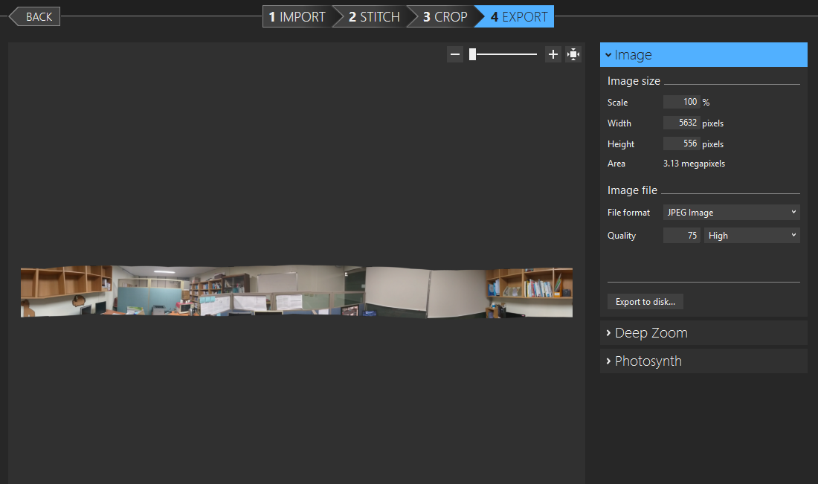
Creating 360 image
Export :

Slide 20
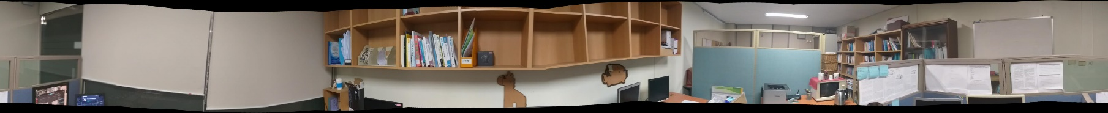
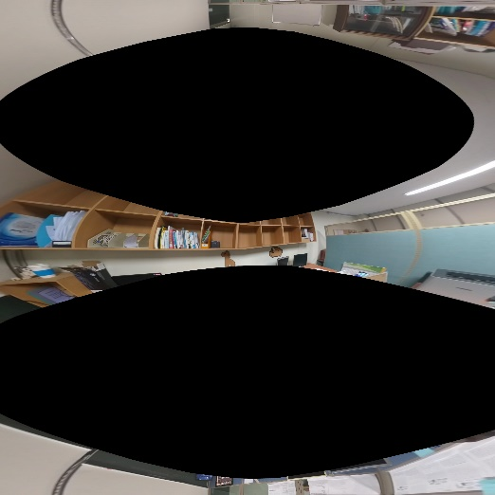
Creating 360 image
Cylindrical :
Transverse Cylindrical
Panoramas in this projection are meant to be viewed as though the image is wrapped into a cylinder and viewed from within. When viewed on a 2D plane, horizontal lines appear curved while vertical lines remain straight.

Slide 21
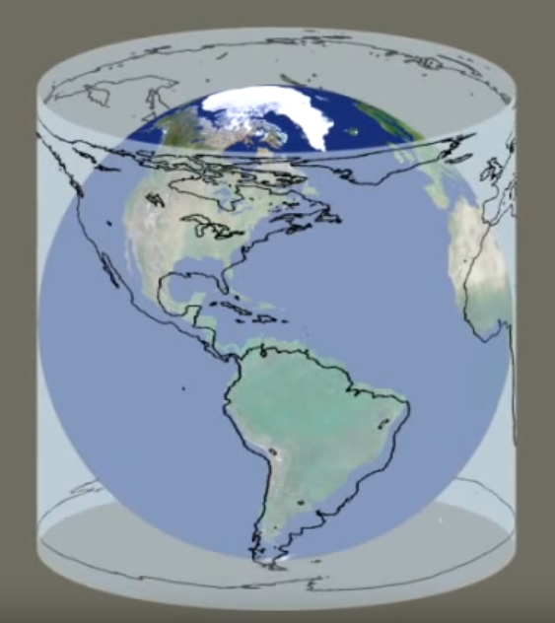
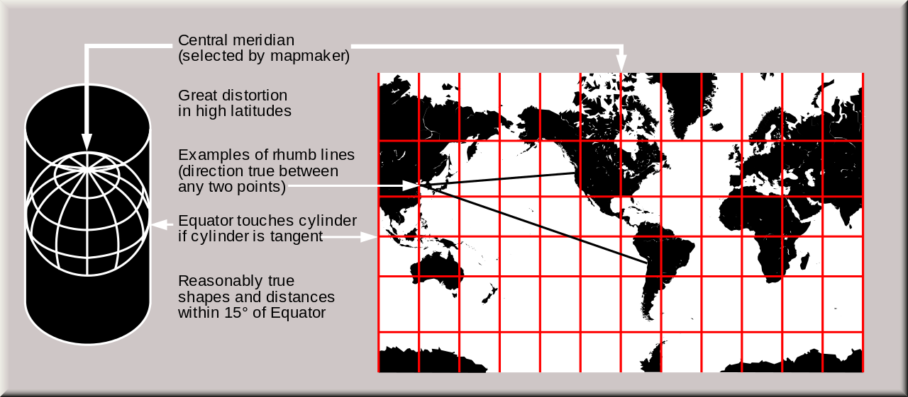
Creating 360 image - Cylindrical Projection

Slide 22
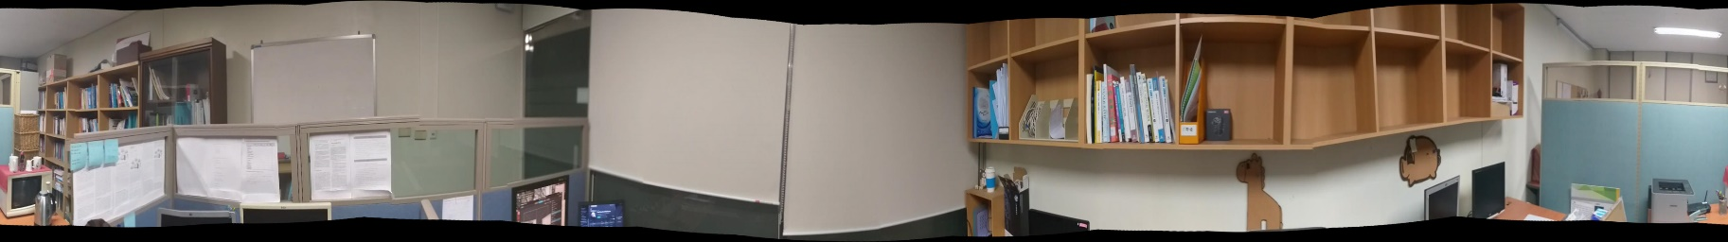
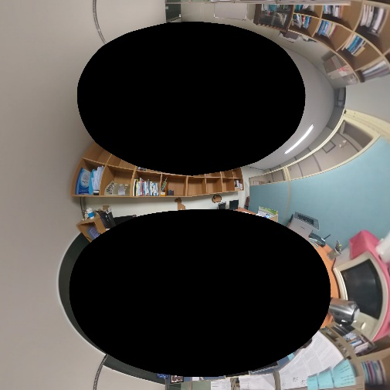
Creating 360 image
Mercator :
Transverse Mercator

Slide 23
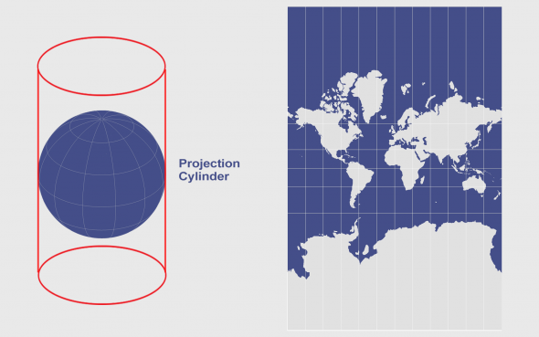
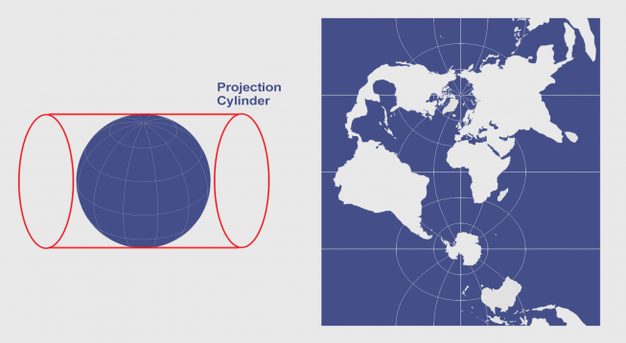
Creating 360 image - Mercator Projection
Mercator
Transverse Mercator

Slide 24
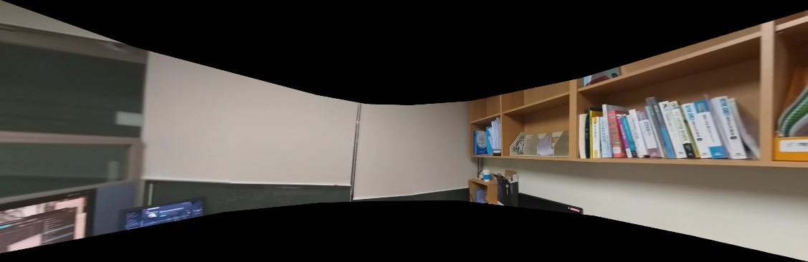
Creating 360 image
Perspective :

Slide 25
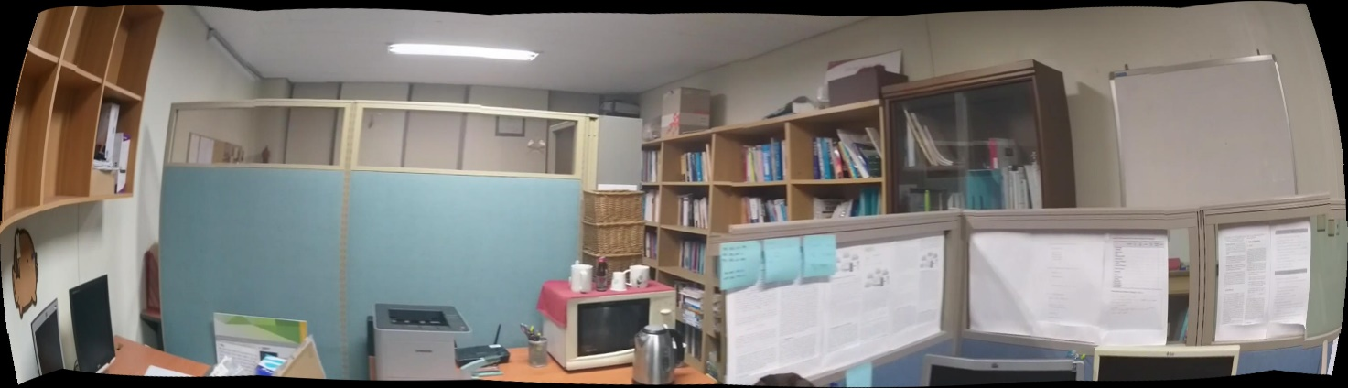
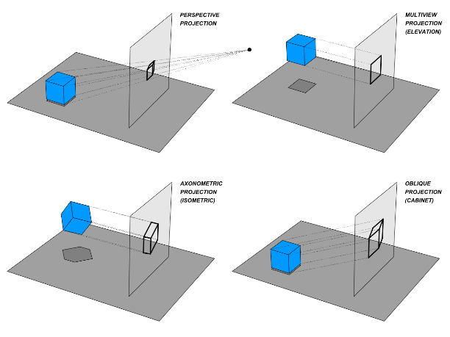
Creating 360 image
Orthographic :
a form of parallel projection, in which all the projection lines are orthogonal to the projection plane,^{[1]}resulting in every plane of the scene appearing in affine transformation on the viewing surface.

Slide 26
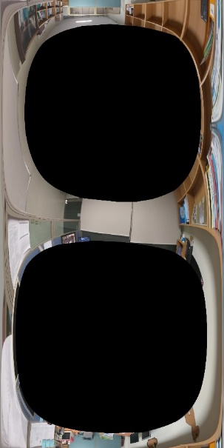
Creating 360 image
Spherical :
Transverse Sperical

Slide 27
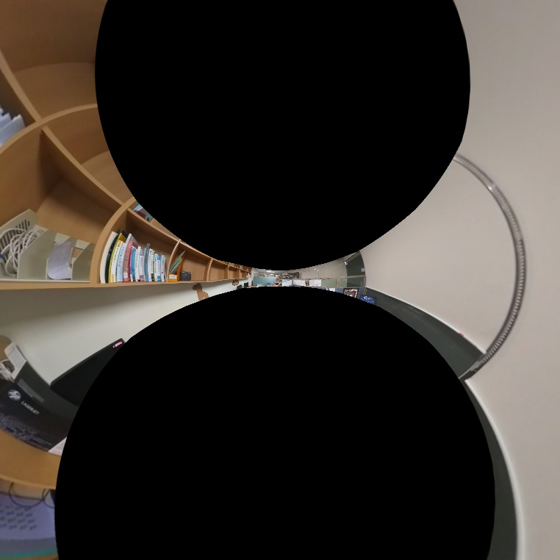
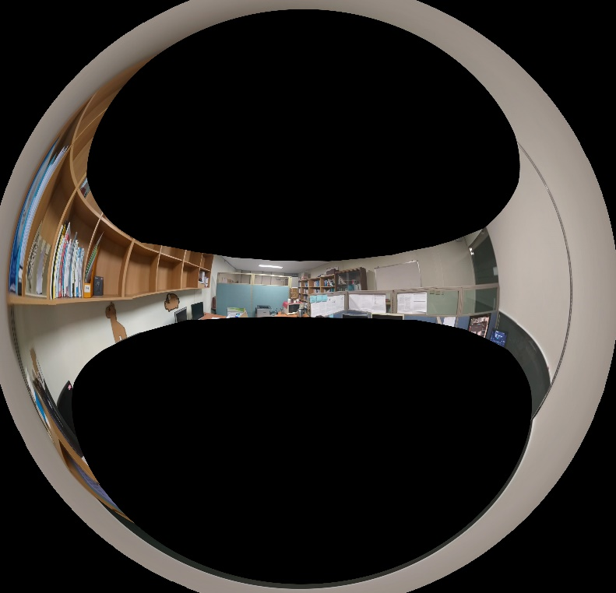
Stereographic | Fisheye

Slide 28
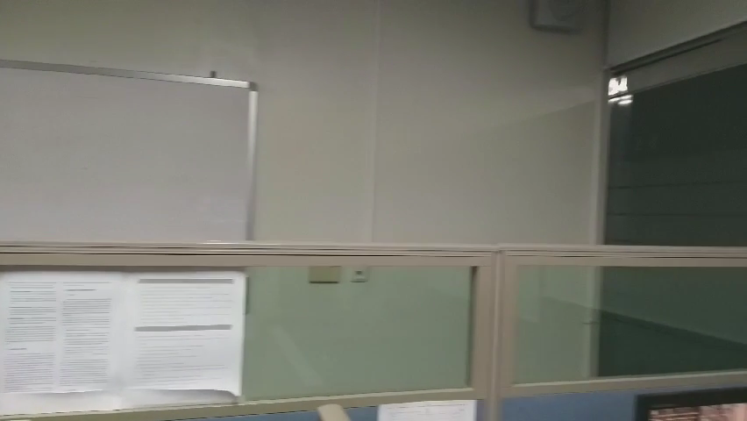
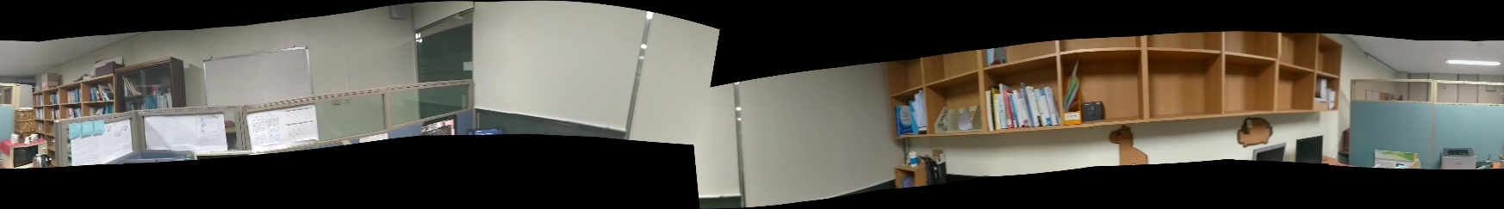
Creating 360 image
Failed Result :

Slide 29
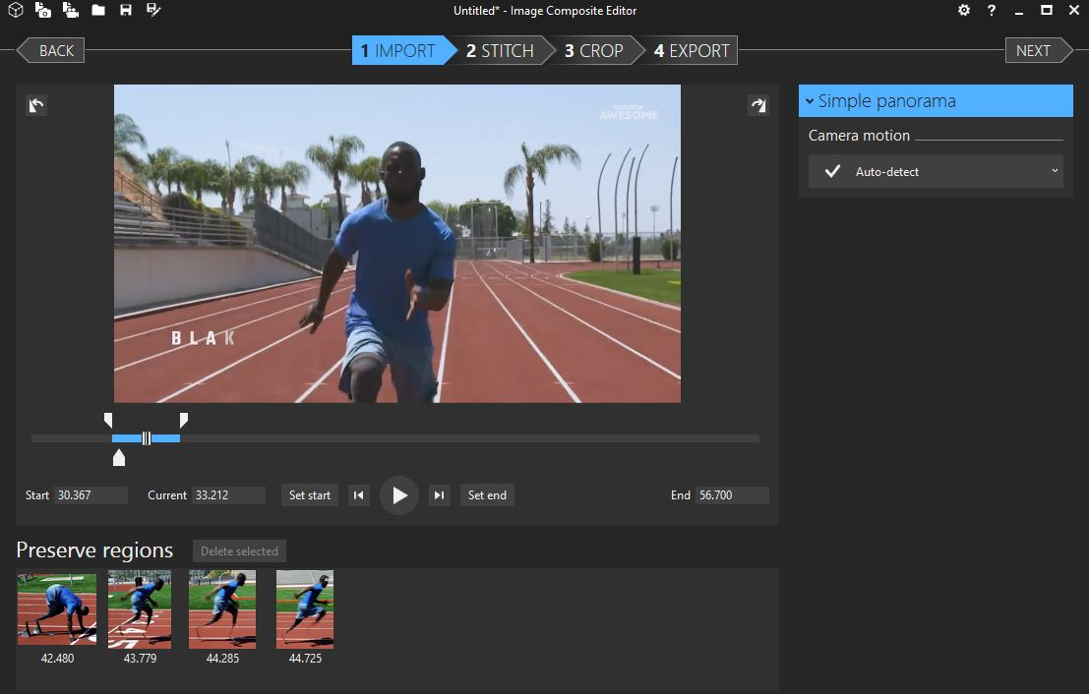
Creating panorama that include moving object
Import :

Slide 30
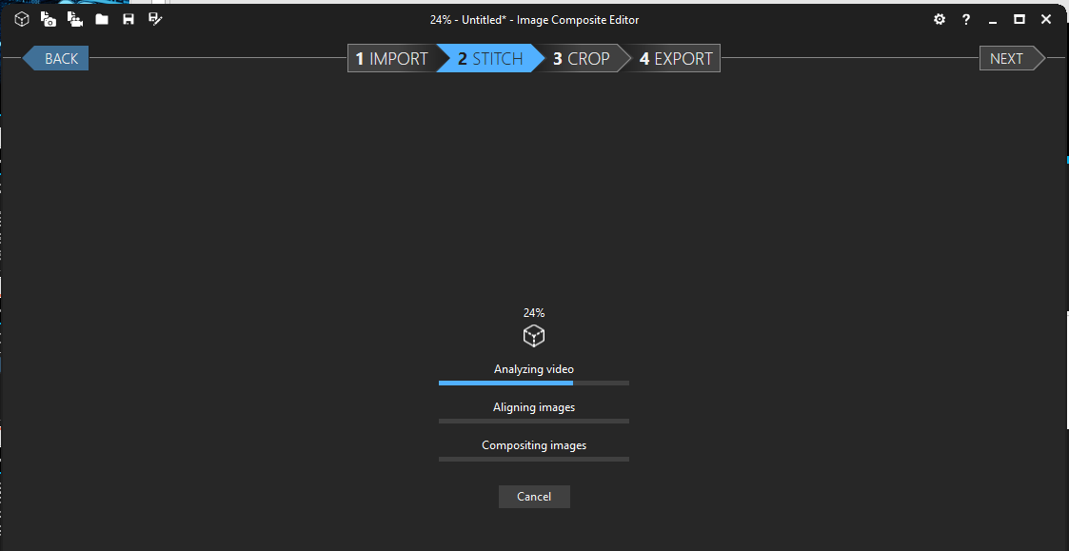
Creating panorama that include moving object
Stitching Process :

Slide 31
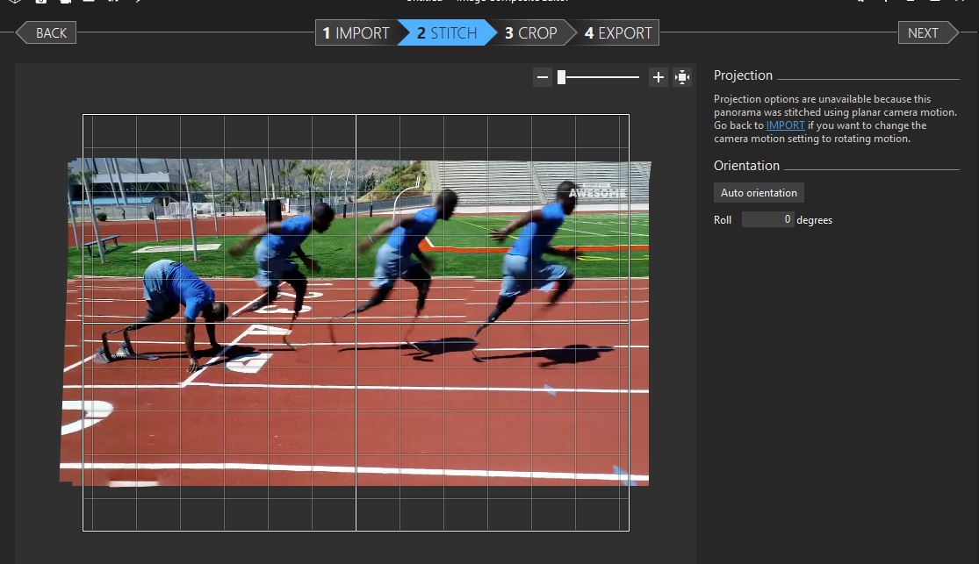
Creating panorama that include moving object
Stitching Result :

Slide 32
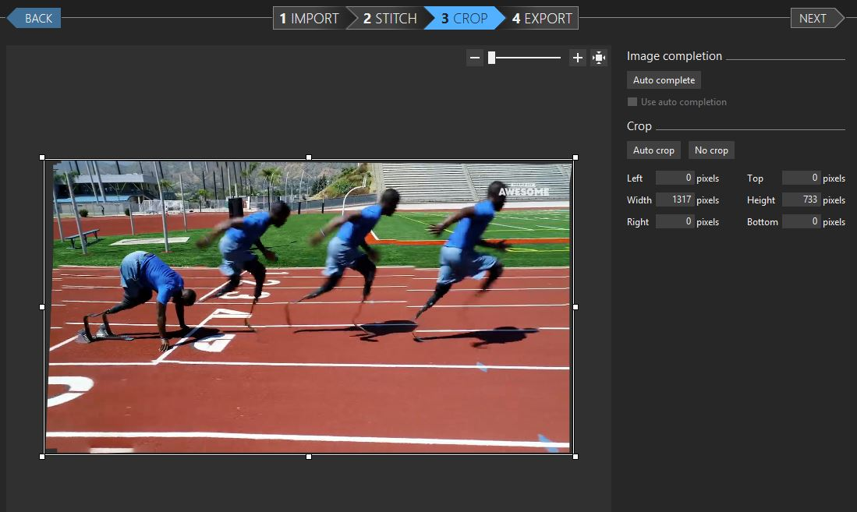
Creating panorama that include moving object
Crop :

Slide 33
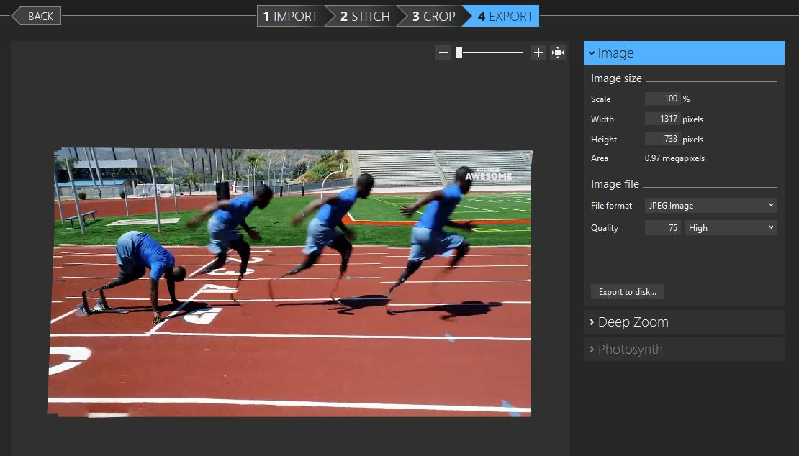
Creating panorama that include moving object
Export :

Slide 34
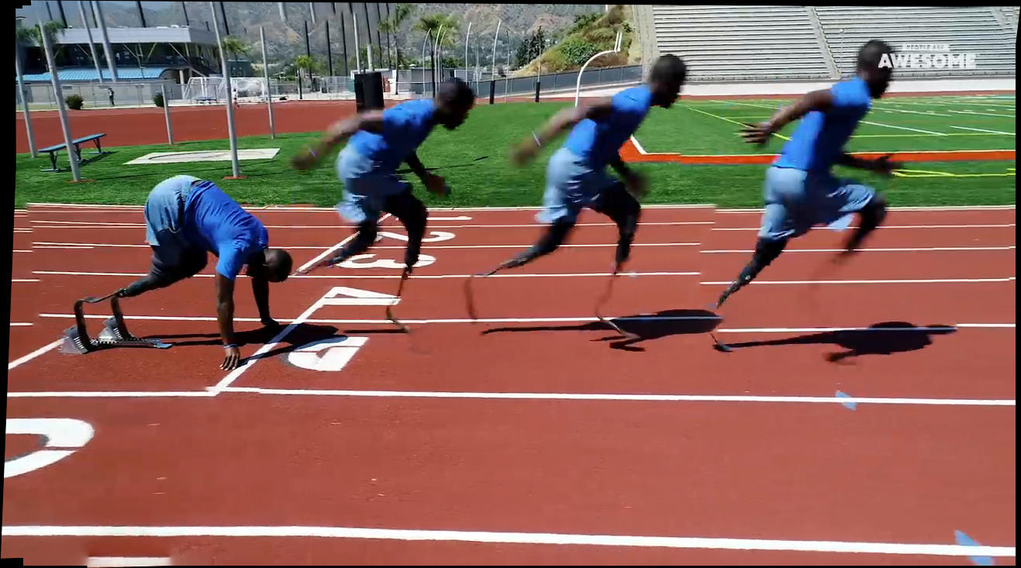
Creating panorama that include moving object
Original Result :

Slide 35
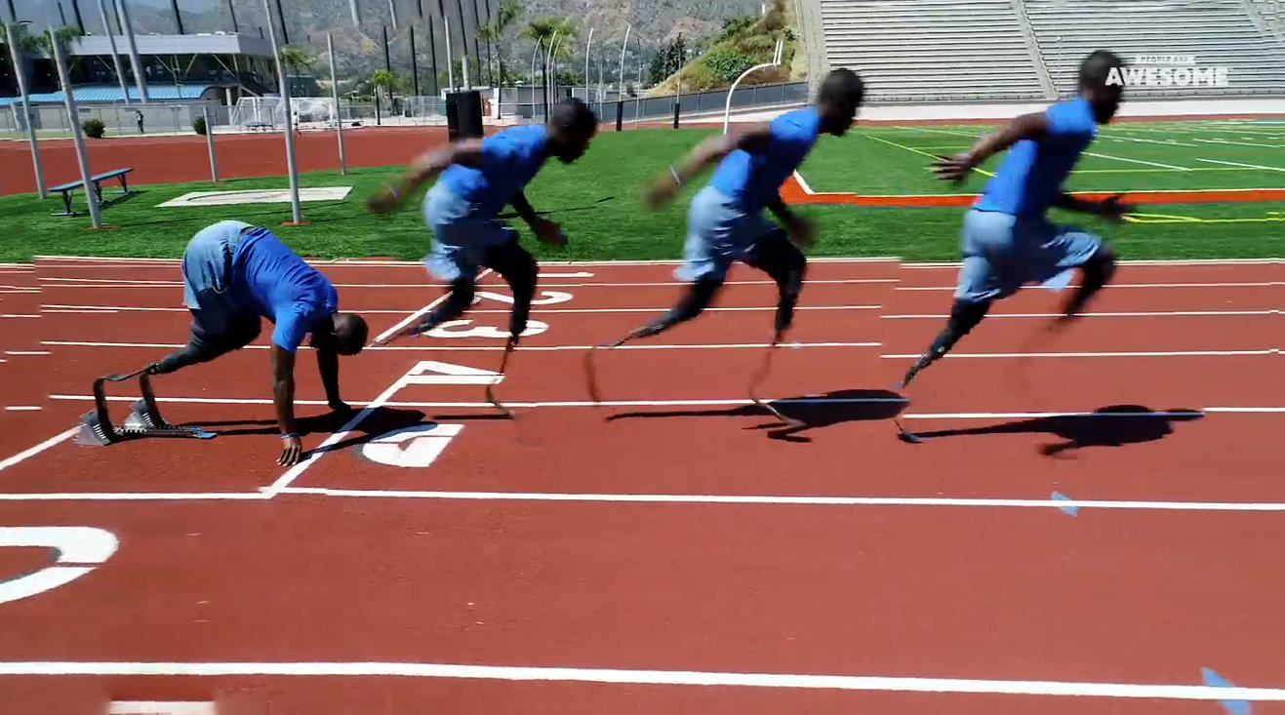
Creating panorama that include moving object
Auto Complete Result :

Slide 36
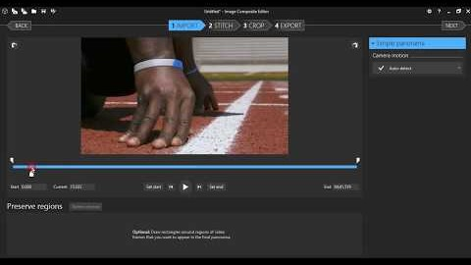
YouTube Video

Slide 37

감사합니다 Thank You
Notes:
This is the question that your experiment answers

